Slide 1

Assignment 6- Transformer Architecture
Rishabh Modi

Slide 2
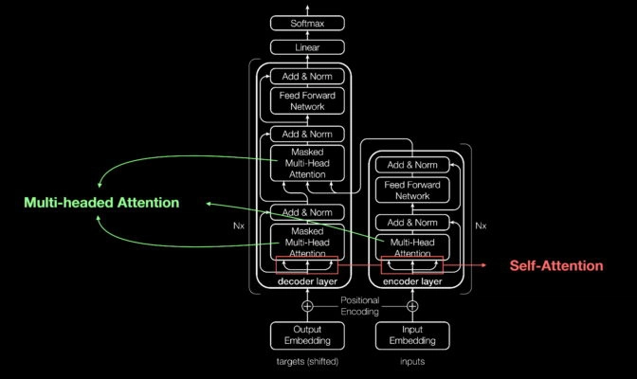
Architecture

Slide 3
Architecture- Structure
There are 2 main components
Encoder
Decoder
Encoder:
Input Embedding: converts tokens into vectors
Positional Encodings- Added to the input embedding to incorporate sequence order
Stacked Layers- Multi-head Attention & Feed Forward Neural Network
Decoder:
Output Embedding: Converts output tokens into vectors
Positional Encoding: Added to the output embedding
Stacked Layers: Multi-head Attention, Multi-head Attention, Feed Forward Neural Network
The Decoder output is passed through a linear layer followed by a softmax

Slide 4
Architecture- Components
Attention Mechanism- It weights the importance of different parts of the input to each other. Employs a mechanism called scaled dot product which has 3 components Query (Q), key (K), Value (V)
Multi-Head Attention- Instead of using one set of Q, K, V the transformer uses multiple sets allowing it to focus on different input parts
Feed Forward Neural Network- Present in both encoder and decoder. Works on the outputs of the multi-head attention layer
Add & Norm (Residual Connection)- Each sub-layer in the transformer is followed by a residual connection & layer Normalization
Positional Encoding- Since there is no in-built notion of sequence order the transformer uses positional encodings added to the embeddings at the input layer
Stacked Layers- Both the encoder and decoder have multiple identical layers stacked on top of each other

Slide 5
Architecture- Encoder
Multi-head Self-Attention Mechanism
Mechanism: For each word, it calculates a weighted representation of the entire sequence, allowing it to consider the entire context. Multi-head means it can focus on multiple contexts simultaneously
Feed-Forward Neural Network
Mechanism: It comprises of 2 linear transformations (dense layers) with a ReLU activation in between
Residual Connection
The output of both the multi-head attention and feed forward neural network is added to their respective inputs before being normalized
Layer Normalized
It normalizes the output of either the multi-head attention or the feed forward network over the last features before being passed to the next layer

Slide 6
Architecture- Decoder
Masked Multi-Head Self Attention Mechanism
Mechanism: Like self-attention mechanism in the encoder but with a mask to block out any future information
Multi-Head Attention over Encoder’s Output
Mechanism: Queries come from the previous decoder layer while keys and values come from the output of the encoder. This allows every position in the decoder to attend to positions in the input sequence
Feed-Forward Neural Network
Same as in the encoder layer
Residual Connection
Same as in the encoder layer
Layer Normalization
Same as in the encoder layer

Slide 7
Advantages & Disadvantages
Advantages
Parallelization: the transformers allows for parallelization as each word or token is processed simultaneously
Long-range Dependencies: The attention mechanism allows the model to distant words and tokens making it capable of handling long range dependencies in the data
Scalability: The model scales well with data and compute resources
Disadvantages
Computational Intensity: Especially with large inputs the self attention mechanism can be computationally expensive
Memory Consumption: Due to numerous parameters and the need to store intermediate activations

